Slide 1
Session 3: Decoding the Call
Proposal Writing Camp
How to understand and analyse a call
How to deconstruct a call text
Group work: Practical exercise on call decoding

Slide 2
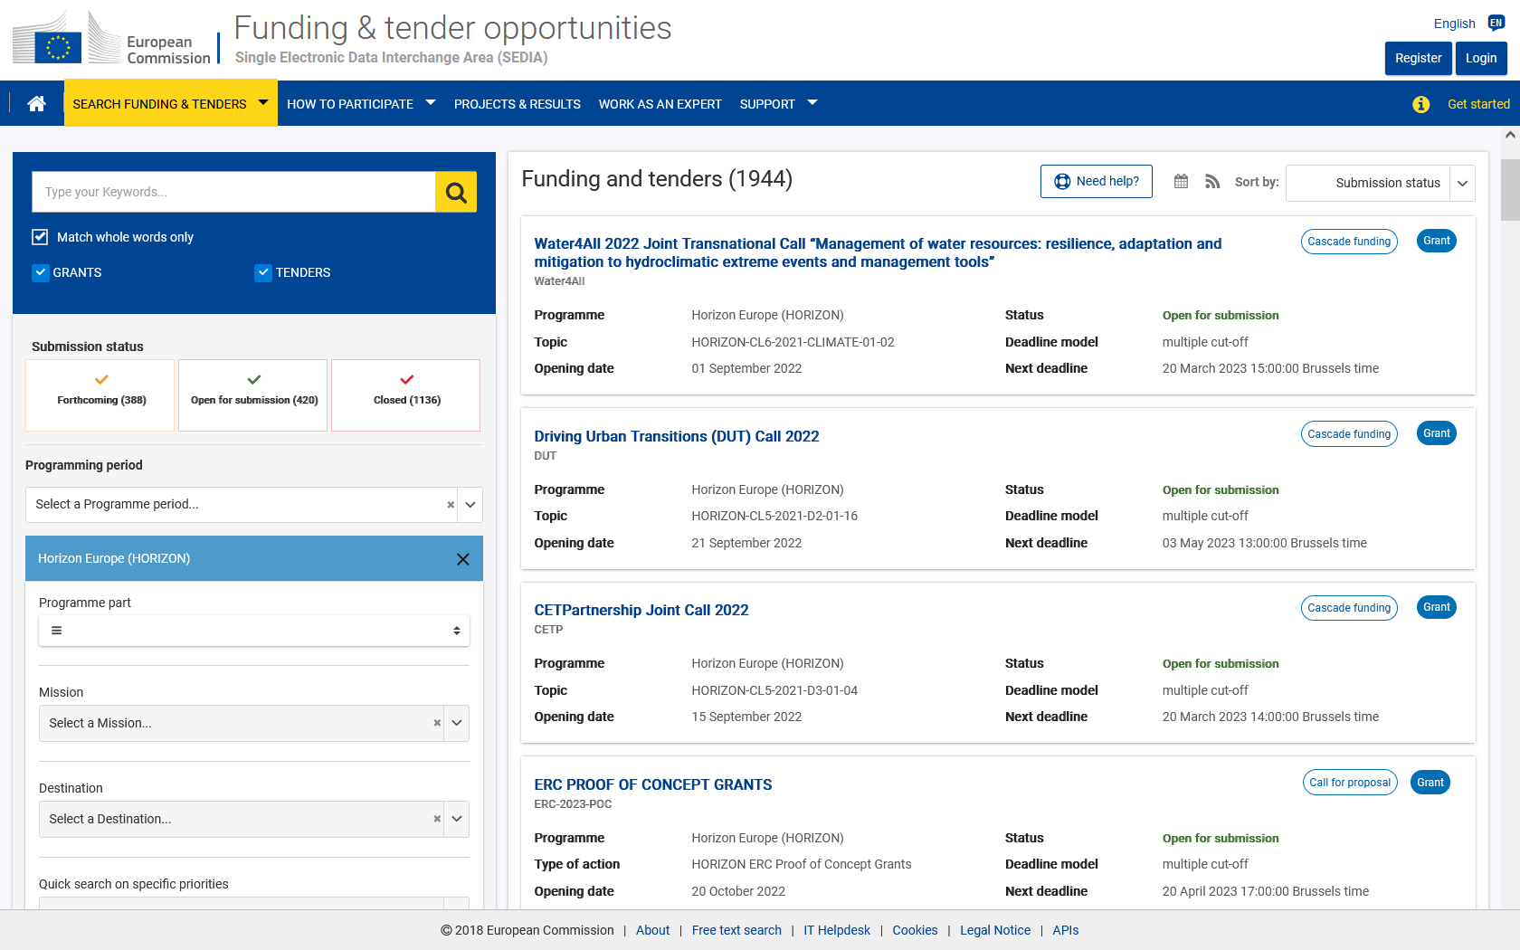
1. Finding, understanding and analysing a call https://ec.europa.eu/info/funding-tenders/opportunities/portal/screen/programmes/horizon https://ec.europa.eu/info/funding-tenders/opportunities/portal/screen/opportunities/topic-search

Slide 3
Call example

Slide 4
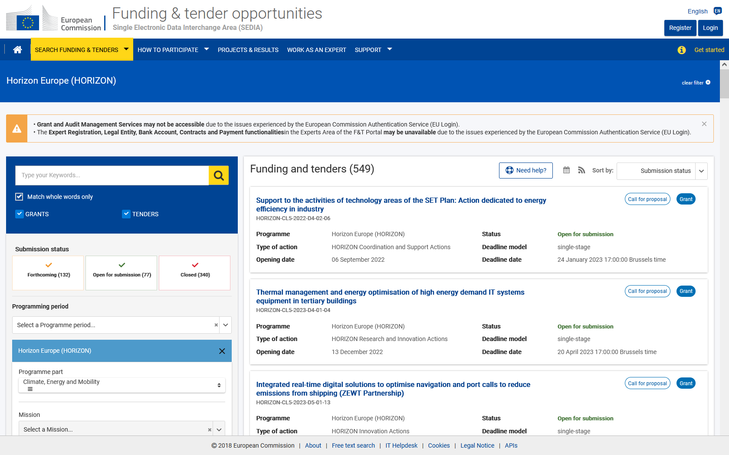
International cooperation in Horizon Europe Work Programme 2021-2022
Funding & Tenders Portal (FTP) – How to find a call? (I)
Left hand menu:
1) Select a programme – Horizon Europe
2) Programme part
https://ec.europa.eu/info/funding-tenders/opportunities/portal/screen/opportunities/topic-search

Slide 5
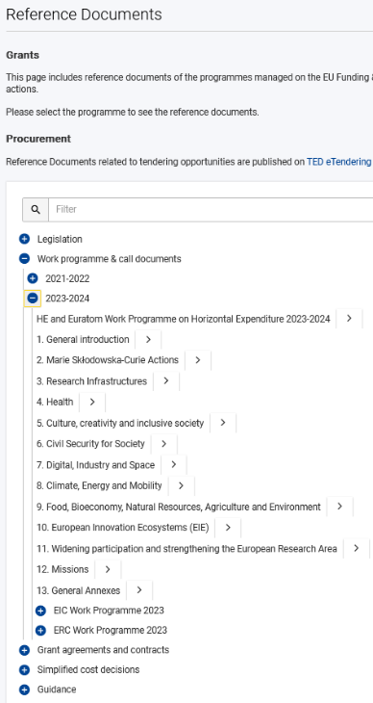
International cooperation in Horizon Europe Work Programme 2021-2022
2. How to find a call? (II)
What information do thematic
work programmes provide?
Introduction
Overview of the scheduled call(s)
Description of the topics
Call Key data:
Opening date, deadline
Type of Action (RIA, CSA, IA, etc)
indicative budget per Topic/Call
one-stage/two-stage procedure
indicative date for evaluation outcome & grant signing
Budget
https://ec.europa.eu/info/funding-tenders/opportunities/portal/screen/how-to-participate/reference-documents;programCode=HORIZON

Slide 6
International cooperation in Horizon Europe Work Programme 2021-2022
Partner Search TOOLS
Use existing contacts with experience of EU funding programmes
Use Partner Search on the Funding and tenders portal: https://ec.europa.eu/info/funding-tenders/opportunities/portal/screen/how-to-participate/partner-search
Search the CORDIS database for participants in similar projects in FP7/H2020/HE: http://cordis.europa.eu/projects/home_en.html
Use social media (e.g. LinkedIn forums)
European NCP networks, National NCPs, COST actions… https://ec.europa.eu/info/funding-tenders/opportunities/portal/screen/support/ncp https://www.cost.eu/cost-actions-event/browse-actions/

Slide 7
Glossary
CRITICAL RISK | A critical risk is a plausible event or issue that could have a high adverse impact on the ability of the project to achieve its objectives. Level of likelihood to occur (Low/medium/high): The likelihood is the estimated probability that the risk will materialise even after taking account of the mitigating measures put in place. Level of severity (Low/medium/high): The relative seriousness of the risk and the significance of its effect.
DELIVERABLE | A report that is sent to the Commission or Agency providing information to ensure effective monitoring of the project. There are different types of deliverables (e.g. a report on specific activities or results, data management plans, ethics or security requirements).
IMPACTS | Wider long term effects on society (including the environment), the economy and science, enabled by the outcomes of R&I investments (long term). It refers to the specific contribution of the project to the work programme expected impacts described in the destination. Impacts generally occur some time after the end of the project.

Slide 8
Glossary
MILESTONE | Control points in the project that help to chart progress. Milestones may correspond to the achievement of a key result, allowing the next phase of the work to begin. They may also be needed at intermediary points so that, if problems have arisen, corrective measures can be taken. A milestone may be a critical decision point in the project where, for example, the consortium must decide which of several technologies to adopt for further development. The achievement of a milestone should be verifiable.
OBJECTIVES | The goals of the work performed within the project, in terms of its research and innovation content. This will be translated into the project’s results. These may range from tackling specific research questions, demonstrating the feasibility of an innovation, sharing knowledge among stakeholders on specific issues. The nature of the objectives will depend on the type of action, and the scope of the topic.
OUTCOMES | The expected effects, over the medium term, of projects supported under a given topic. The results of a project should contribute to these outcomes, fostered in particular by the dissemination and exploitation measures. This may include the uptake, diffusion, deployment, and/or use of the project’s results by direct target groups. Outcomes generally occur during or shortly after the end of the project.

Slide 9
Glossary
PATHWAY TO IMPACT | Logical steps towards the achievement of the expected impacts of the project over time, in particular beyond the duration of a project. A pathway begins with the projects’ results, to their dissemination, exploitation and communication, contributing to the expected outcomes in the work programme topic, and ultimately to the wider scientific, economic and societal impacts of the work programme destination.
RESEARCH OUTPUT | Results generated by the action to which access can be given in the form of scientific publications, data or other engineered outcomes and processes such as software, algorithms,
RESULTS | What is generated during the project implementation. This may include, for example, know-how, innovative solutions, algorithms, proof of feasibility, new business models, policy recommendations, guidelines, prototypes, demonstrators, databases and datasets, trained researchers, new infrastructures, networks, etc. Most project results (inventions, scientific works, etc.) are ‘Intellectual Property’, which may, if appropriate, be protected by formal ‘Intellectual Property Rights’.
TRL | TECHNOLOGY READINESS LEVEL - See annex B

Slide 10
2. How to decode a call text

Slide 11
Deconstructing a call text
Specific Conditions: main information about the call
Expected Outcomes: what is supposed to be achieved
Scope: presents what exactly is expected to be done

Slide 12
Decoding a call text
Specific Conditions: main information about the call
Expected Outcomes: what is supposed to be achieved
Scope: presents what exactly is expected to be done
Outcomes …→ Impact
Research & Innovation Work to be done
Consortium
→ Check Destination as additional /background information/policy context (see Work programme)

Slide 13
3. How to deconstruct a call text
Group Work
Read carefully the Horizon Europe topic chosen as an example for the hands-on exercise;
Sort the information and highlight all words and sentences related to the colour code
Work (Underline) Consortium (“C” in margin)
Impact (“I” in margin; at second step/later) Budget (Circle any relative info)

Slide 14
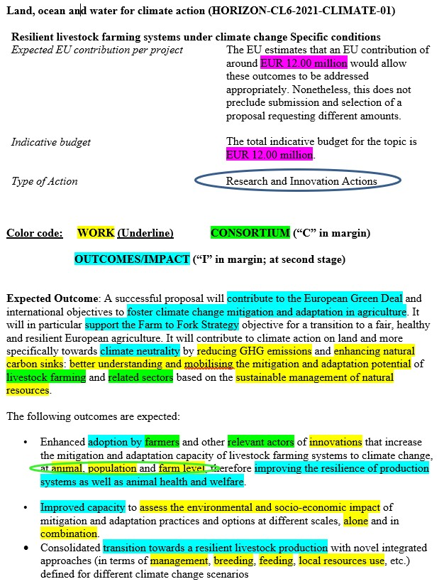

Slide 15
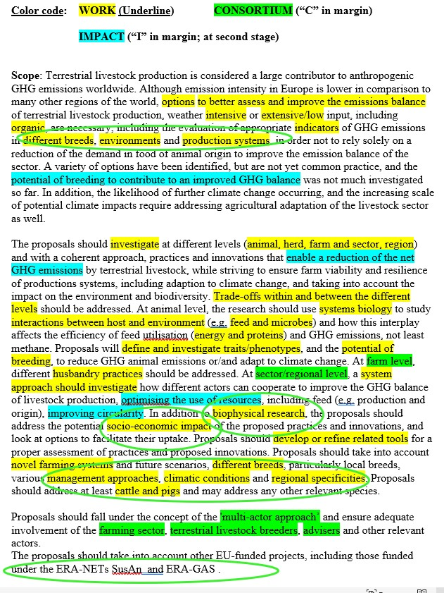

Slide 16
Group WORK – DECODING CALLS

